Slide 1


Presented by Ramish F Shu
Cyclistic Bike Usage
Trends and challenges
See all context

Slide 2

Objectives
To understand how casual riders and annual members use Cyclistic bikes differently.
Support marketing efforts to convert casual riders into annual members by identifying usage patterns.

Slide 3
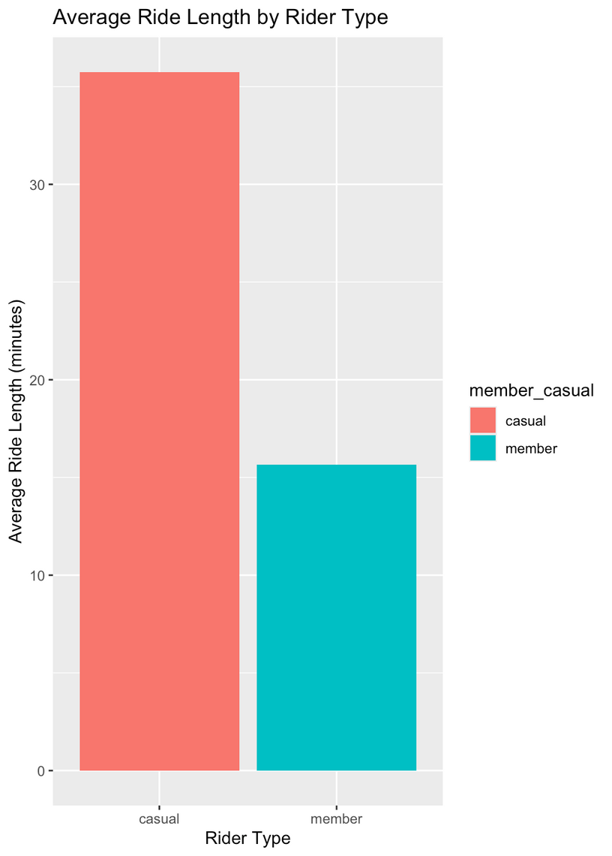
Average Ride Length by Rider Type
Insight: Casual riders tend to have longer rides than members, suggesting they may use the service more for leisure.
Implication: Highlighting benefits of shorter commute rides or offering incentives for longer rides might attract casual users to membership.

Slide 4
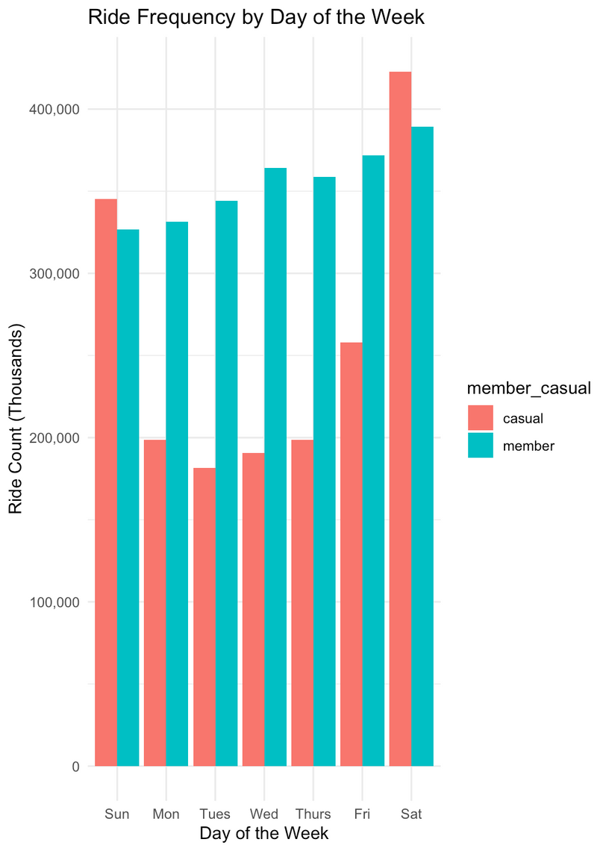
Ride Frequency by Day of the Week
Insight: Casual riders are most active on weekends, while members show consistent usage on weekdays.
Implication: Marketing efforts could focus on weekend promotions to convert casual riders who primarily ride during leisure times.

Slide 5
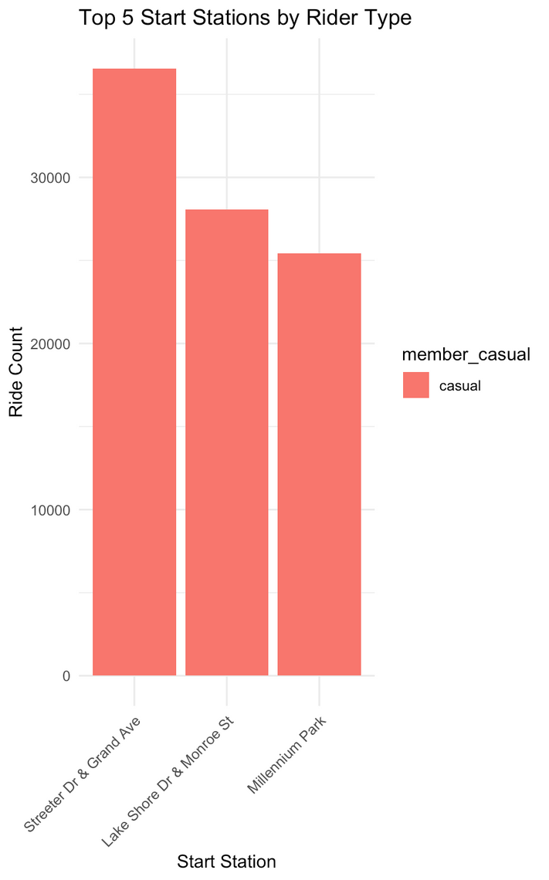
Top 5 Start Stations by Rider Type
Insight: Streeter Dr & Grand Ave, Lake Shore Dr & Monroe St, and Millennium Park are the most popular starting points for casual riders.
Implication: These locations could be targeted with marketing material promoting membership benefits.

Slide 6
Key Findings Summary
01.
02.
03.
Casual riders have significantly longer average ride times than members.
Casual riders are more active on weekends, while members use bikes consistently throughout the week.
Specific start locations are more popular with casual riders, indicating potential target locations for conversion efforts.

Slide 7
Recommendations
Weekend Promotions
Targeted Advertising at Popular Stations
Highlight Membership Benefits
Target casual riders with weekend-only promotions.
Display promotional material at popular stations like Streeter Dr & Grand Ave
Emphasize the cost savings and convenience for frequent riders, especially those with longer ride durations.

Slide 8

Thank you very much!
Ramish F Shu

